Slide 1


Slide 2

Winning Hearts to Influence Minds
Set: Organizing for Power
Notes:
We are starting from the end of the process. You will be going through a workshop on the start of bargaining and on communicating.

Slide 3
How did we Get here?
For the purpose of this workshop, we will start at the end of negotiations.
We have already surveyed and received proposal from the membership.
We have exchanged proposals and negotiated with the employer.
But ……
Notes:
The employer is cheep and we need to put pressure on them to get them to show us the money.

Slide 4
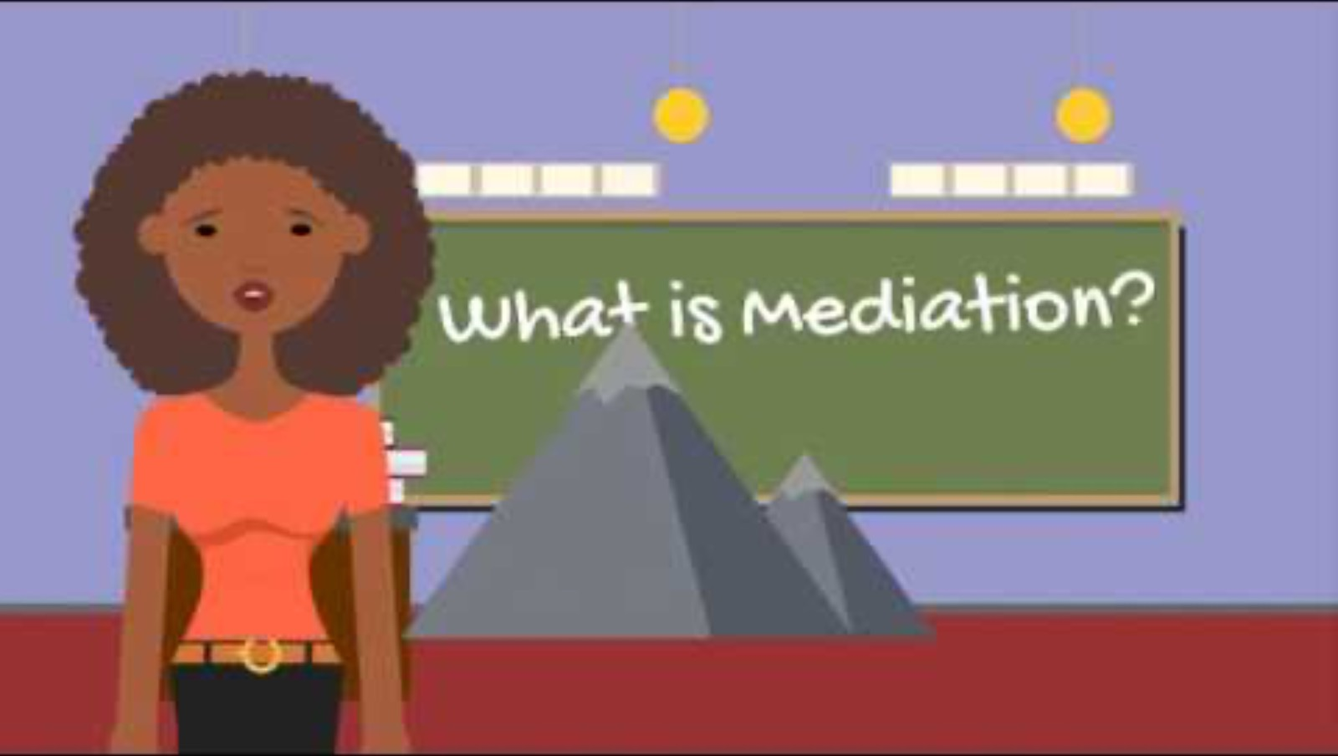
Notes:
- the differences between 64, 65, enhanced mediations and essential services

Slide 5



Please download and install the Slido app on all computers you use
Audience Q&A was removed
When can the mediator write out?
ⓘ Start presenting to display the audience questions on this slide.
Notes:
Introduce Slido and ask the members to scan the app and get ready to answer questions about Collective Bargaining

Slide 6

Please download and install the Slido app on all computers you use
When can the mediator write out?
ⓘ Start presenting to display the poll results on this slide.
Notes:
Q1 - When can the mediator write out? (vote pick an answer)
After 2 days of mediation
When they want to
When they are told to
When the Union and the Company agree
negotiation, the above
In the normal curse of negotiation, the answer is C – the mediator is normally asked by one party to write out

Slide 7

Please download and install the Slido app on all computers you use
What do we need to do to be prepared to have the mediator write out?
ⓘ Start presenting to display the poll results on this slide.
Notes:
Q2 - What do we need to do to be prepared to have the mediator write out?
Write in answer and have the words get bigger based on what words are used most.

Slide 8
Please download and install the Slido app on all computers you use
What is the first thing that happens when mediator writes out?
ⓘ Start presenting to display the poll results on this slide.
Notes:
Q3 - What is the first thing that happens when mediator writes out? (review strike votes and constitution requirements)
Union can give 72-hour notice of a strike
The Company can give 72-hour notice of a lockout
The government will get involved
The government will implement a 14-day cooling off period
The union can take a strike vote, and the company can take a lockout vote
review strike votes and constitution requirements

Slide 9
Please download and install the Slido app on all computers you use
We are in a strike position. What will people get paid for strike benefit?
ⓘ Start presenting to display the poll results on this slide.
Notes:
Q4 – We are in a strike position. What will people get paid for strike benefit? (Hand out NDF Flyers show NDF video)
$50 a day
$300 a week
$400 a week
$500 a week
$700 a week
$1000 a week
Handout NDF Flyer and show NDF video next slide

Slide 10


Slide 11
Please download and install the Slido app on all computers you use
What should the union make sure members know about striking?
ⓘ Start presenting to display the poll results on this slide.
Notes:
Q5 – What should the union make sure members know about striking?
Write in answer and have the words get bigger based on what words are used most.
(hand out Strike manual)

Slide 12
Please download and install the Slido app on all computers you use
Why is secondarily picketing and leaflet so importance?
ⓘ Start presenting to display the poll results on this slide.
Notes:
Q6 – Why is secondarily picketing and leaflet so importance?
It will affect the company’s business
It will put pressure on the company
It can put pressure on the government to act
It will put pressure on other companies doing business with your company
All of the above

Slide 13
Notes:
Bayshore – what are we do now and how you can help
20 min
Walk the group through how we build this campaign - hand out materials and use them as examples.
Member engagement - the members need to know this is coming. (statement to avoid charges and open bargaining)
Why is this a public campaign?
How can you help? Have everyone sign the petition and share it on their social media

